Slide 1
Petrol Price Forecasting
Main aim of this project is to predict/forecaste the correct Oil/Petrol price for the upcoming dates using machine learning technique and Auto ML

Slide 2
Prediction
In the long term,the indian Gasoline prices is projected to trend around 1.05 USD/liter in 2022 and 1.00 USD/Liter in 2023,according to econometric model.
Petrol Price are going continuously these days and it has become very hard to predict what will be the price range next few months or even days

Slide 3
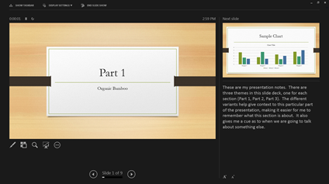
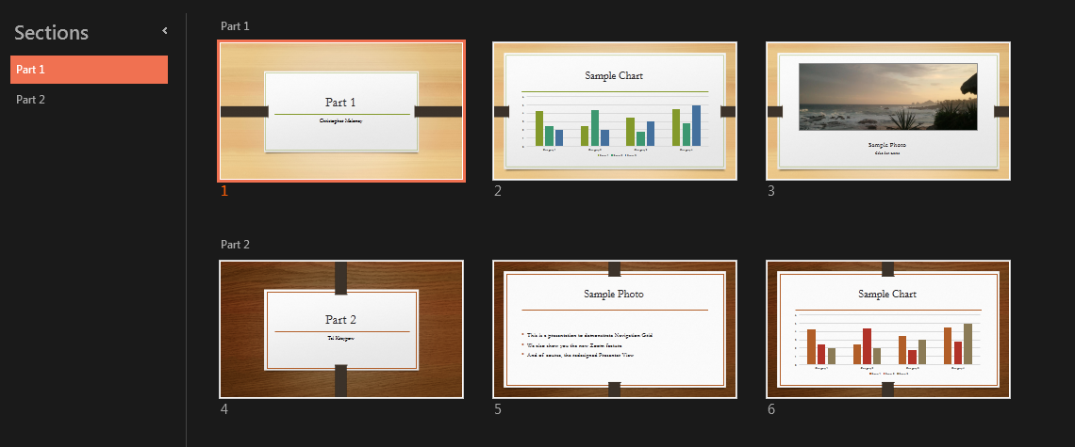
What we will do
In this project we will try to forecaste the different petrol price for the upcoming dates given to us.
We will use LSTM and ARIMA forecasting model to predict the price that we will see how we can implement the same using autokeras ,which is auto ml library.

Slide 4
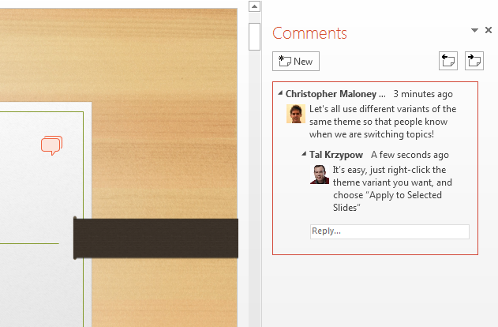
Work Together
LSTM:Long short term meomary is an artificial recurrent neural network used in the field of deep learning. Unlike standard feed forward neural network,LSTM has feedback connection. It can process not only single data point, but also entire sequences of data.
ARIMA:An arima is a class of statically models for analyzing and forecasting time series data. Arima is an acronomy that stands for auto regressive integrated moving average.it is generalization of the simpler Auto Regressive moving average and adds the notion of integration.

Slide 5
Auto Keras
An auto ML system based on keras.it is developed by data lab at Texax A&M university.The goal of Autokeras is to make machine learning accessible to everyone
This are certain application:1]Regressor
2]Image classifier
3]Object detection
Find out more at the PowerPoint Getting Started Center
(Click the arrow when in Slide Show mode)
Notes:
In Slide Show mode, click the arrow to enter the PowerPoint Getting Started Center.

Slide 6
